Slide 1
The Book of Why
Chapter 7

Slide 2
Beyond Adjustment: The Conquest of Mount Intervention
Back door adjustment
Front door criterion
Do-Calculus
Examples – Instrumental Variables

Slide 3
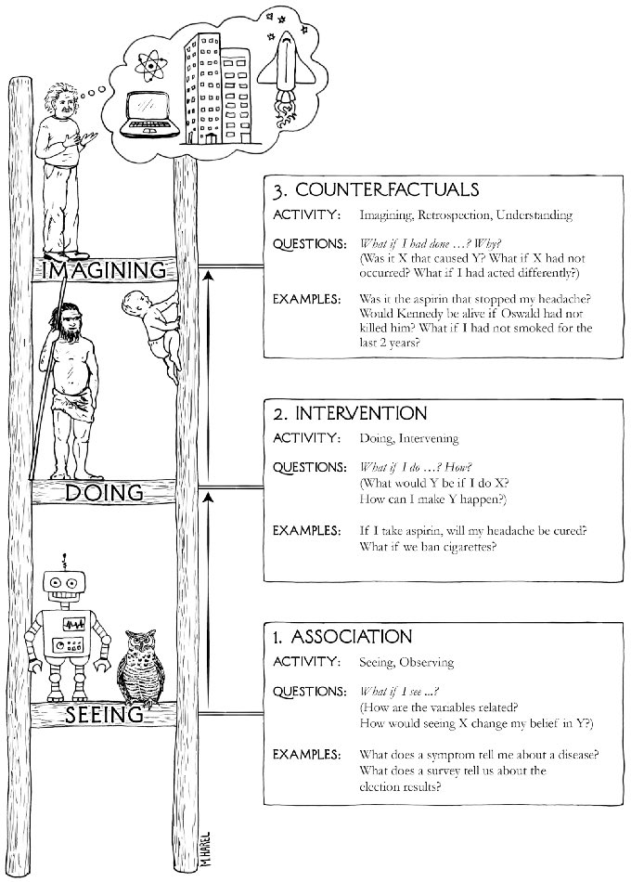
Quick recap
Ladder of Causation (p28)
Back door criterion (p157)
A
C
B
X
Y
Game 5 (p162)
“A back door path is any path from X to Y that starts with an arrow pointing into X”

Slide 4
Back door adjustment (p220)
Need back door criterion or you’re just guessing
Stratify
If it’s linear: use regression and take the coefficient!
… which is what people do anyway
X
Y
Unobservable

Slide 5
Front door criterion (p224)
Smoking gene
Invisible assumptions:
No arrow from Smoking gene to Tar
Smoking doesn’t have other routes to Cancer other than through Tar
Smoking → Tar
Tar → Cancer
Smoking
Tar
Cancer
Smoking
Tar
Tar
Unobservable
Smoking
Smoking gene
Cancer
Collider
Tar
Cancer
Tar
Smoking
Smoking gene
Cancer

Slide 6
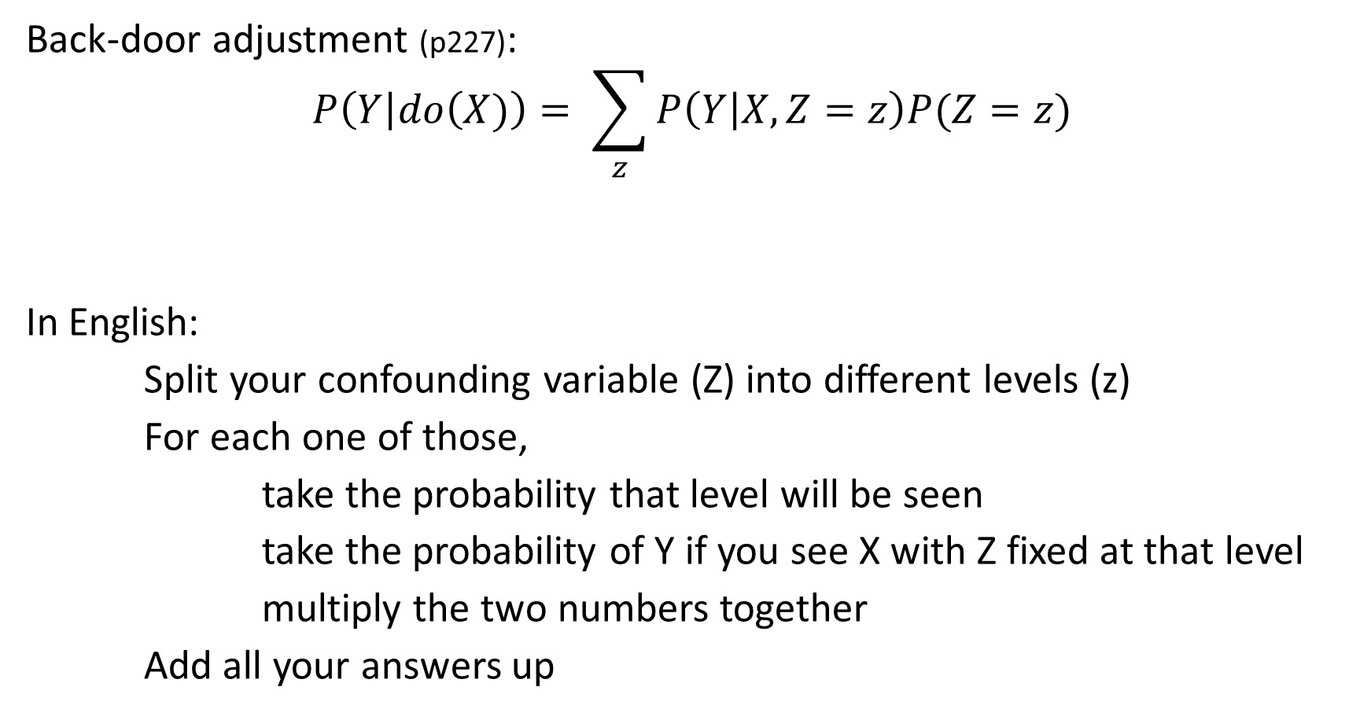
The do-Calculus
No “do” operator – Judea is pleased about this
Back-door adjustment (p227):
$$P\left(Y\right|do\left(X)\right)= \sum_{z}{P\left(Y | X, Z=z\right)P(Z=z)}$$
In English:
Split your confounding variable (Z) into different levels (z)
For each one of those,
take the probability that level will be seen
take the probability of Y if you see X with Z fixed at that level
multiply the two numbers together
Add all your answers up
“Do” so this is a level 2 question
This is the “Estimand”: the instructions for how to answer the question

Slide 7
The do-Calculus
Three axioms, which are a combination of maths and properties of the causal diagram (p234)
If you know the state of a mediator, you can ignore what adjusts it
If you’ve blocked all back-door paths, do(X) = see(X)
You can remove do(X) when there isn’t a causal path from X to Y
Solve more complicated problems using algebra

Slide 8
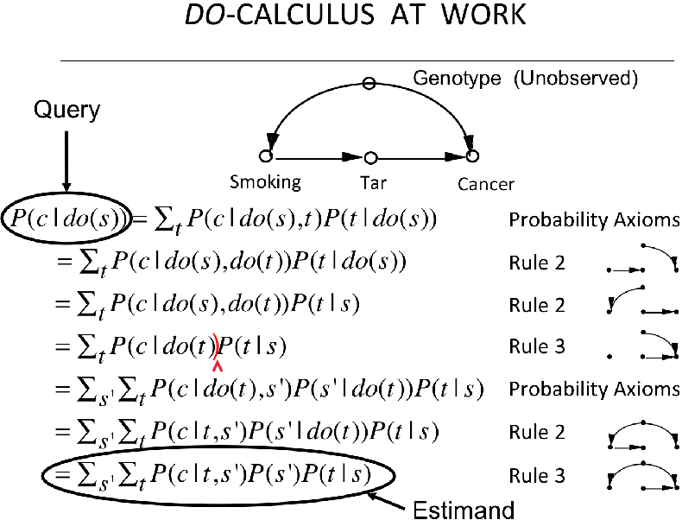
Introduce tar – is this blocking paths?
Add a do around t
Remove do around the final s
Remove do(s)
Introduce s’… controlling on s?
Remove do around first t
Remove do(t)

Slide 9
The curious case of Dr Snow (p245)
Miasma, Poverty etc.
A diagram to compare two competing theories
Miasma (etc.) causes cholera
The water company did
Water company is called an instrumental variable
Can measure the bottom two arrows
Assume linear
Measure WC → WP directly
Measure WC → Cholera (Miasma route is blocked)
We can answer “What if everyone received the good water?”
Water company
Water Purity
Cholera
The diagram represents both theories, but is also the results of Snow’s work e.g. miasma is not linked to water company

Slide 10
Cholesterol: RCT non-compliance (p252)
Confounder (U)
The RCT results will show P(Y|Z)
This will underestimate the effect
The confounder here is whether the people who didn’t take the drug were different somehow
Check the three assumptions:
Is Z independent of U?
Is there a direct path from Z to Y?
Is there a strong association between Z and X?
Assigned (Z)
Received (X)
Cholesterol (Y)
This is the same diagram as on the last slide, only with new labels
Here the answers are easy, but we are using causal intuition to answer them (apparently)

Slide 11
Cholesterol: RCT non-compliance (p252)
Confounder (U)
Outcome (X,Y) | Not Assigned Drug (Z = 0) | Assigned Drug (Z = 1)
No drug, no improvement (0, 0) | 919 | 315
Drug, no improvement (1, 0) | 0 | 139
No drug, Improved (0, 1) | 81 | 73
Drug, Improved (1, 1) | 0 | 473
Assigned (Z)
Received (X)
Cholesterol (Y)
Set to 1,000 people in each group
Binary, so we can’t use the linear maths from earlier (phew!)
Worst case 39.2% - none of the people who didn’t take the drug would have improved
Best case 78.0% - all of the people who didn’t take the drug would have improved
I really don’t understand where the causality comes in though

